Slide 1
M Tech(Data Science & Engineering) Introduction to Statistical Methods
Name of the Faculty and Location

Slide 2
Session No 3 and 4

Slide 3
Agenda
Random Variables – Discrete and Continuous
Probability Distributions
Expected Value and Variance
Binomial Probability Distribution
Poisson Probability Distribution
Normal Distribution
.40
.30
.20
.10
0 1 2 3 4

Slide 4
Random Variables
A random variable is a variable hat assumes numerical values associated with the random outcome of an experiment, where one (and only one) numerical value is assigned to each sample point.

Slide 5
Random Variables
A random variable is a numerical description of the outcome of an experiment.
A random variable can be classified as being either discrete or continuous depending on the numerical values it assumes.
A discrete random variable may assume either a finite number of values or an infinite sequence of values.
A continuous random variable may assume any numerical value in an interval or collection of intervals.

Slide 6
Types of random Variables
A discrete random variable can assume a countable number of values.
Number of steps to the top of the Eiffel Tower*
A continuous random variable can assume any value along a given interval of a number line.
The time a tourist stays at the top
once s/he gets there
*Believe it or not, the answer ranges from 1,652 to 1,789. See Great Buildings

Slide 7


Two Types of Random Variables
Discrete random variables
Number of sales
Number of calls
Shares of stock
People in line
Mistakes per page
Continuous random variables
Length
Depth
Volume
Time
Weight

Slide 8
Probability Distributions for Discrete Random Variables
The probability distribution of a discrete random variable is a graph, table or formula that specifies the probability associated with each possible outcome the random variable can assume.
p(x) ≥ 0 for all values of x
Σp(x) = 1

Slide 9
4.2: Probability Distributions for Discrete Random Variables
x | P(x)
1 | .30
2 | .21
3 | .15
4 | .11
5 | .07
6 | .05
7 | .04
8 | .02
9 | .02
10 | .01
Say a random variable x follows this pattern: p(x) = (.3)(.7)^{x-1}
for x > 0.
This table gives the probabilities (rounded to two digits) for x between 1 and 10.

Slide 10
Expected Values of Discrete Random Variables
The mean, or expected value, of a discrete random variable is

Slide 11
Expected Values of Discrete Random Variables
The variance of a discrete random variable x is
The standard deviation of a discrete random variable x is

Slide 12
Example: JSL Appliances
Discrete random variable with a finite number of values
Let x = number of TV sets sold at the store in one day
where x can take on 5 values (0, 1, 2, 3, 4)
Discrete random variable with an infinite sequence of values
Let x = number of customers arriving in one day
where x can take on the values 0, 1, 2, . . .
We can count the customers arriving, but there is no finite upper limit on the number that might arrive.

Slide 13
Discrete Probability Distributions
The probability distribution for a random variable describes how probabilities are distributed over the values of the random variable.
The probability distribution is defined by a probability function, denoted by f(x), which provides the probability for each value of the random variable.
The required conditions for a discrete probability function are:
f(x) > 0
Σf(x) = 1
We can describe a discrete probability distribution with a table, graph, or equation.

Slide 14
Example : JSL Appliances
Using past data on TV sales (below left), a tabular representation of the probability distribution for TV sales (below right) was developed.

Slide 15
Example: JSL Appliances
Graphical Representation of the Probability Distribution
.50
.40
Probability
.30
.20
.10
0 1 2 3 4
Values of Random Variable x (TV sales)

Slide 16
Discrete Uniform Probability Distribution
The discrete uniform probability distribution is the simplest example of a discrete probability distribution given by a formula.
The discrete uniform probability function is
f(x) = 1/n
where:
n = the number of values the random
variable may assume
Note that the values of the random variable are equally likely.

Slide 17
Expected Value and Variance
The expected value, or mean, of a random variable is a measure of its central location.
Expected value of a discrete random variable:
E(x) = μ = Σxf(x)
The variance summarizes the variability in the values of a random variable.
Variance of a discrete random variable:
Var(x) = σ ² = Σ(x - μ)²f(x)
The standard deviation, σ, is defined as the positive square root of the variance.

Slide 18
Example: JSL Appliances
Expected Value of a Discrete Random Variable
The expected number of TV sets sold in a day is 1.2

Slide 19
Example: JSL Appliances
Variance and Standard Deviation
of a Discrete Random Variable
x x - μ (x - μ)² f(x) (x - μ)²f(x)
0 -1.2 1.44 .40 .576
1 -0.2 0.04 .25 .010
2 0.8 0.64 .20 .128
3 1.8 3.24 .05 .162
4 2.8 7.84 .10 .784
1.660 = σ ²
The variance of daily sales is 1.66 TV sets squared.
The standard deviation of sales is 1.2884 TV sets.

Slide 20
Binomial Probability Distribution
Properties of a Binomial Experiment
The experiment consists of a sequence of n identical trials.
Two outcomes, success and failure, are possible on each trial.
The probability of a success, denoted by p, does not change from trial to trial.
The trials are independent.

Slide 21
Example: Evans Electronics
Binomial Probability Distribution
Evans is concerned about a low retention rate for employees. On the basis of past experience, management has seen a turnover of 10% of the hourly employees annually. Thus, for any hourly employees chosen at random, management estimates a probability of 0.1 that the person will not be with the company next year.
Choosing 3 hourly employees a random, what is the probability that 1 of them will leave the company this year?
Let: p = .10, n = 3, x = 1

Slide 22
Binomial Probability Distribution
Binomial Probability Function
where:
f(x) = the probability of x successes in n trials
n = the number of trials
p = the probability of success on any one trial

Slide 23
Example: Evans Electronics
Using the Binomial Probability Function
= (3)(0.1)(0.81)
= .243

Slide 24
Example: Evans Electronics
Using the Tables of Binomial Probabilities

Slide 25
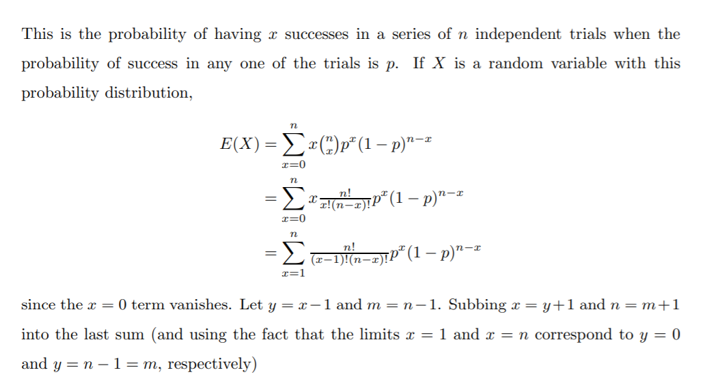
Mean and variance of Binomial distribution
http://www.math.ubc.ca/~feldman/m302/binomial.pdf

Slide 26
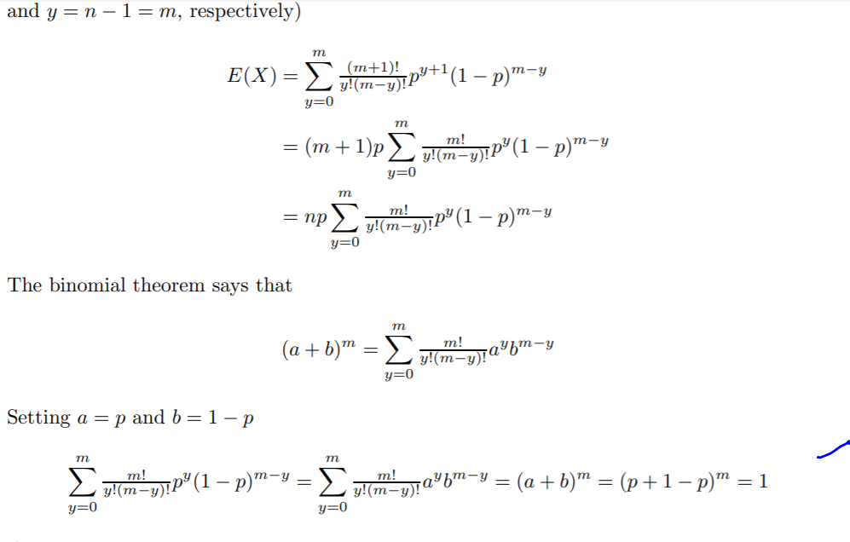

Slide 27
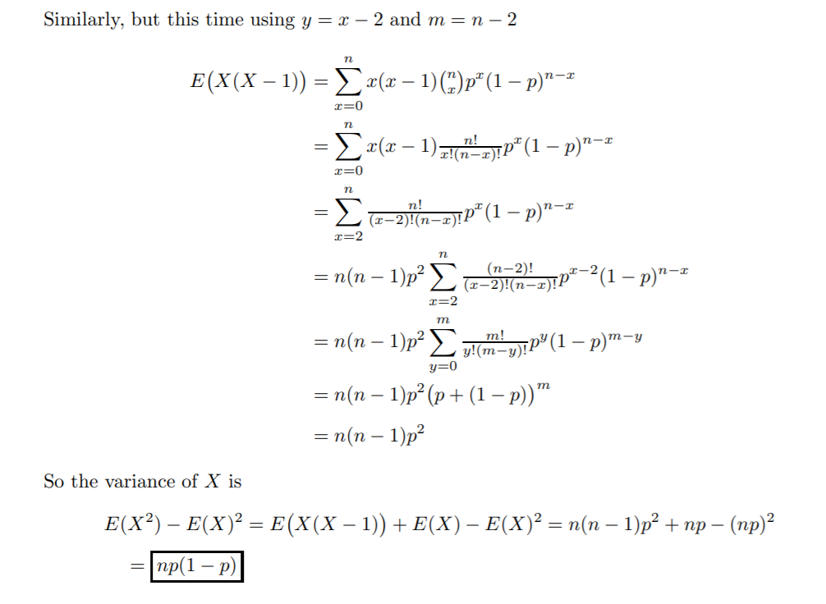

Slide 28
Example: Evans Electronics
First
Worker
Second
Worker
Third
Worker
Value
of x
Probab.
L (.1)
3
.0010
Leaves (.1)
S (.9)
2
.0090
Leaves (.1)
L (.1)
2
.0090
Stays (.9)
S (.9)
1
.0810
L (.1)
2
.0090
Leaves (.1)
S (.9)
1
.0810
Stays (.9)
L (.1)
1
.0810
Stays (.9)
S (.9)
0
.7290

Slide 29
Binomial Probability Distribution
Expected Value
E(x) = μ = np
Variance
Var(x) = σ ² = np(1 - p)
Standard Deviation

Slide 30
Example: Evans Electronics
Binomial Probability Distribution
Expected Value
E(x) = μ = 3(.1) = .3 employees out of 3
Variance
Var(x) = σ ² = 3(.1)(.9) = .27
Standard Deviation

Slide 31
Poisson Probability Distribution
Properties of a Poisson Experiment
The probability of an occurrence is the same for any two intervals of equal length.
The occurrence or nonoccurrence in any interval is independent of the occurrence or nonoccurrence in any other interval.

Slide 32
References
https://medium.com/@andrew.chamberlain/deriving-the-poisson-distribution-from-the-binomial-distribution-840cc1668239
Derivation of Normal from some principles
https://web.sonoma.edu/users/w/wilsonst/papers/Normal/default.html
Data mining with R Learning with case studies
http://www.stat.yale.edu/~pollard/Courses/241.fall97/Normal.pdf
Normal distribution st. forward
http://physics.gu.se/~frtbm/joomla/media/mydocs/LennartSjogren/kap2.pdf
Book for preprocessing with stats and probability
http://www.bagualu.net/wordpress/wp-content/uploads/2015/10/Data_Mining_with_R__Learning_with_Case_Studies.pdf

Slide 33
Poisson Probability Distribution
Poisson Probability Function
where:
f(x) = probability of x occurrences in an interval
μ = mean number of occurrences in an interval
e = 2.71828

Slide 34
Example: Mercy Hospital
Using the Poisson Probability Function
Patients arrive at the emergency room of Mercy Hospital at the average rate of 6 per hour on weekend evenings. What is the probability of 4 arrivals in 30 minutes on a weekend evening?
μ = 6/hour = 3/half-hour, x = 4

Slide 35
Example: Mercy Hospital
Using the Tables of Poisson Probabilities

Slide 36
Continuous Probability Distributions
Uniform Probability Distribution
Normal Probability Distribution
Exponential Probability Distribution
f(x)
x
μ

Slide 37
Continuous Probability Distributions
A continuous random variable can assume any value in an interval on the real line or in a collection of intervals.
It is not possible to talk about the probability of the random variable assuming a particular value.
Instead, we talk about the probability of the random variable assuming a value within a given interval.
The probability of the random variable assuming a value within some given interval from x₁ to x₂ is defined to be the area under the graph of the probability density function between x₁ and x₂.

Slide 38
Normal Probability Distribution
Graph of the Normal Probability Density Function
f(x)
x
μ

Slide 39
Normal Probability Distribution
Characteristics of the Normal Probability Distribution
The shape of the normal curve is often illustrated as a bell-shaped curve.
Two parameters, μ (mean) and σ (standard deviation), determine the location and shape of the distribution.
The highest point on the normal curve is at the mean, which is also the median and mode.
The mean can be any numerical value: negative, zero, or positive.
… continued

Slide 40
Normal Probability Distribution
Characteristics of the Normal Probability Distribution
The normal curve is symmetric.
The standard deviation determines the width of the curve: larger values result in wider, flatter curves.
The total area under the curve is 1 (.5 to the left of the mean and .5 to the right).
Probabilities for the normal random variable are given by areas under the curve.

Slide 41
Normal Probability Distribution
% of Values in Some Commonly Used Intervals
68.26% of values of a normal random variable are within +/- 1 standard deviation of its mean.
95.44% of values of a normal random variable are within +/- 2 standard deviations of its mean.
99.72% of values of a normal random variable are within +/- 3 standard deviations of its mean.

Slide 42
Normal Probability Distribution
Normal Probability Density Function
where:
μ = mean
σ = standard deviation
π = 3.14159
e = 2.71828

Slide 43
Standard Normal Probability Distribution
A random variable that has a normal distribution with a mean of zero and a standard deviation of one is said to have a standard normal probability distribution.
The letter z is commonly used to designate this normal random variable.
Converting to the Standard Normal Distribution
We can think of z as a measure of the number of standard deviations x is from μ.

Slide 44
Example: Pep Zone
Standard Normal Probability Distribution
Pep Zone sells auto parts and supplies including a
popular multi-grade motor oil. When the stock of this
oil drops to 20 gallons, a replenishment order is placed.
The store manager is concerned that sales are being
lost due to stockouts while waiting for an order. It has
been determined that leadtime demand is normally
distributed with a mean of 15 gallons and a standard
deviation of 6 gallons.
The manager would like to know the probability of a
stockout, P(x > 20).

Slide 45
Example: Pep Zone
Standard Normal Probability Distribution
The Standard Normal table shows an area of .2967 for the region between the z = 0 and z = .83 lines below. The shaded tail area is .5 - .2967 = .2033. The probability of a stock-out is .2033.
z = (x - μ)/σ
= (20 - 15)/6
= .83
Area = .2967
Area = .5 - .2967
= .2033
Area = .5
z
0
.83

Slide 46
Example: Pep Zone
Using the Standard Normal Probability Table

Slide 47
Example: Pep Zone
Standard Normal Probability Distribution
If the manager of Pep Zone wants the probability of a stockout to be no more than .05, what should the reorder point be?
Let z_{.05} represent the z value cutting the .05 tail area.
Area = .05
Area = .5
Area = .45
0
z_{.05}

Slide 48
Example: Pep Zone
Using the Standard Normal Probability Table
We now look-up the .4500 area in the Standard Normal Probability table to find the corresponding z_{.05} value.
z_{.05} = 1.645 is a reasonable estimate.

Slide 49
Example: Pep Zone
Standard Normal Probability Distribution
The corresponding value of x is given by
x = μ + z_{.05}σ
= 15 + 1.645(6)
= 24.87
A reorder point of 24.87 gallons will place the probability of a stockout during leadtime at .05. Perhaps Pep Zone should set the reorder point at 25 gallons to keep the probability under .05.

Slide 50
Thanks
Queries?

